Slide 1
Behavioral VHDL Coding for Synthesis

Slide 2
Outline
Behavioral VHDL Coding for Synthesis
  Process Statement
  Behavioral VHDL Statements: If/Then, Wait, Case, For Loop, While Loop
  Sequential Logic: Latches, Flip-Flops, Registers, Shift Registers, Counters

Slide 3
Behavioral VHDL Statements

Slide 4
VHDL Design Styles (Architecture)
VHDL Design
Styles
BEHAVIORAL
DATAFLOW
STRUCTURAL
SYNTHESIZABLE
NON-
SYNTHESIZABLE
“concurrent”
statements
components and
interconnects
“sequential” statements
Sequential Logic
(registers,
counters, etc.)
State machines
Complex Comb. Logic
Test Benches
Modeling IP
Gates
Simple Comb. Logic

Slide 5
Behavioral Code
Behavioral code also referred to as “sequential code”
Behavioral code is characterized by PROCESS STATEMENTS
  In process statements, sections of code are executed sequentially—order matters!
  This is unlike dataflow (i.e. concurrent) code, in which order does not matter

Slide 6
Anatomy of a Process
OPTIONAL
[label:] process [(sensitivity list)]
[declaration part]
begin
statement part
end process [label];

Slide 7
Sensitivity List
List of signals to which the process is sensitive.
  Whenever there is an event on any of the signals in the sensitivity list, the process fires.
  If an event occurs on a signal not listed in the sensitivity list, process does not fire
Every time the process fires, it will run in its entirety.
When designing synthesizable code, use a sensitivity list
Process without a sensitivity list is used in a testbench
  Usually not synthesizable
  It will begin firing at the beginning of simulation
  When it finishes it will start at beginning of process (unless WAIT command issued)
  See Lecture 1 for more details
process (sensitivity list)
declaration part
begin
statement part
end process;

Slide 8
Declaration Part
Declaration part (optional)
  Lists variables of the process; signals are declared in architecture declaration
  Variables versus signals
    Variables exist only locally in a process. To get variable’s value out of process, need to assign to signal
    Variable within a process is updated immediately; signal within a process is updated at the end of the process
    Variables use :=, signals use <=
    Read Pedroni Chapter 7 for more information
  Variables can be std_logic_vector, signed, unsigned, integer, etc.
    In this class only entity ports should be std_logic or std_logic_vector
    Variables, signals, generics can be other data types
process (sensitivity list)
declaration part
begin
statement part
end process;

Slide 9
Statement Part
Statement Part
  Contains sequential statements to be executed each time the process Is activated
Analogous to conventional programming languages
process (sensitivity list)
declaration part
begin
statement part
end process;
WITHIN THE STATEMENT PART, THE SEQUENCE OF OPERATIONS MATTERS!!

Slide 10
Processes in VHDL
Processes Describe Sequential Behavior
Processes in VHDL Are Very Powerful Statements
  Allow to define an arbitrary behavior that may be difficult to represent by a real circuit
  Not every process can be synthesized
Use Processes with Caution in the Code to Be Synthesized
Use Processes Freely in Testbenches

Slide 11
If Statement
If statement
else and elsif are optional
Most commonly used type of statement
if boolean expression then
statements
elsif boolean expression then
statements
else boolean expression then
statements
end if;

Slide 12
If Statement-Example
SELECTOR: process
begin
WAIT UNTIL Clock'EVENT AND Clock = '1' ;
IF Sel = "00" THEN
f <= x1;
ELSIF Sel = "10" THEN
f <= x2;
ELSE
f <= x3;
END IF;
end process;

Slide 13
Wait Statements
WAIT UNTIL
  Syntax: WAIT UNTIL signal_condition;
  Explanation: Accepts one signal, waits until signal condition before going to next statement in the process.
  Example: WAIT UNTIL (clk'EVENT and clk='1');
  Synthesizable: Yes (Can use in synthesizable code and testbenches)
WAIT ON
  Syntax: WAIT ON signal1 [,signal2,…];
  Explanation: Accepts multiple signals, waits until any of the signals change.
  Example: WAIT ON clk,rst;
  Synthesizable: Yes (Can use in synthesizable code and testbenches)
WAIT FOR
  Syntax: WAIT FOR time
  Explanation: Wait for a certain amount of time before going to next statement in process.
  Synthesizable: No (Can use in testbenches only)
WAIT (i.e. wait forever)
  Syntax: WAIT
  Explanation: Waits forever, i.e. never goes to the next statement in process.
  Synthesizable: No (Can use in testbenches only)
TESTBENCHES
ONLY

Slide 14
Case Statement
Case statement
Choices have to cover all possible values of the condition
  Use others to specify all remaining cases
case condition is
when choice_1 =>
statements
when choice_2 =>
statements
when others =>
statements
end case;

Slide 15
For Loop
For Loop Statement
Repeats a section of VHDL code sequentially (i.e. order matters)
This is different from generate statement which is concurrent (order does not matter)
[label:] for i in range loop
statements
end loop [label];

Slide 16
While Loop
While Loop Statement
Repeats a section of VHDL code sequentially (i.e. order matters)
Checks a condition before execution
[label:] while condition loop
statements
end loop [label];

Slide 17
Constants

Slide 18
Constants
Syntax:
CONSTANT name : type := value;
Examples:
CONSTANT init_value : STD_LOGIC_VECTOR(3 downto 0) := "0100";
CONSTANT ANDA_EXT : STD_LOGIC_VECTOR(7 downto 0) := X"B4";
CONSTANT counter_width : INTEGER := 16;
CONSTANT buffer_address : INTEGER := 16#FFFE#;
CONSTANT clk_period : TIME := 20 ns;
CONSTANT strobe_period : TIME := 333.333 ms;

Slide 19
Constants - Features
Constants can be declared in a
PACKAGE, ENTITY, ARCHITECTURE
When declared in a PACKAGE, the constant
is truly global, for the package can be used
in several entities.
When declared in an ARCHITECTURE, the
constant is local, i.e., it is visible only within this architecture.
When declared in an ENTITY declaration, the constant
can be used in all architectures associated with this entity.

Slide 20
Combinational Circuit Design

Slide 21
Multiplexers
log₂n selection inputs
n inputs
1 output
multiplexer
  n binary inputs (binary input = 1-bit input)
  log₂n binary selection inputs
  1 binary output
  Function: one of n inputs is placed onto output
  Called n-to-1 multiplexer

Slide 22
2-to-1 Multiplexer
s
s
f
w
0
0
0
w
w
f
0
1
1
1
w
1
(a) Graphical symbol
(b) Truth table
w
0
s
f
w
1
(c) Sum-of-products circuit

Slide 23
4-to-1 Multiplexer
s
0
s
1
s
1
s
0
f
w
0
00
0
0
w
0
w
1
01
f
0
1
w
1
w
2
10
1
0
w
w
3
11
w
2
1
1
3
(a) Graphic symbol
(b) Truth table
s
0
w
0
s
1
w
1
f
w
2
w
3
(c) Circuit

Slide 24
Decoders
w
y
2
n
–
1
n-1
n
inputs
2
n
w
outputs
0
Enable
En
y
0
Decoder
  n binary inputs
  2^{n} binary outputs
  Function: decode encoded information
    If enable=1, one output is asserted high, the other outputs are asserted low
    If enable=0, all outputs asserted low
  Often, enable pin is not needed (i.e. the decoder is always enabled)
  Called n-to-2^{n} decoder
    Can consider n binary inputs as a single n-bit input
    Can consider 2^{n} binary outputs as a single 2^{n}-bit output
  Decoders are often used for RAM/ROM addressing

Slide 25
2-to-4 Decoder
En
w
1
w
0
y
3
y
2
y
1
y
0
w
1
y
3
1
0
0
0
0
0
1
w
y
1
0
1
0
0
1
0
0
2
1
1
0
0
1
0
0
y
1
1
1
1
1
0
0
0
En
y
0
0
-
-
0
0
0
0
(a) Truth table
(b) Graphical symbol
w
0
y
0
w
1
y
1
y
2
y
3
En
(c) Logic circuit

Slide 26
Demultiplexers
log₂n selection inputs
1 input
n outputs
Demultiplexer
  1 binary input
  n binary outputs
  log₂n binary selection inputs
  Function: places input onto one of n outputs, with the remaining outputs asserted low
  Called 1-to-n demultiplexer
Closely related to decoder
  Can build 1-to-n demultiplexer from log₂n-to-n decoder by using the decoder's enable signal as the demultiplexer's input signal, and using decoder's input signals as the demultiplexer's selection input signals.

Slide 27
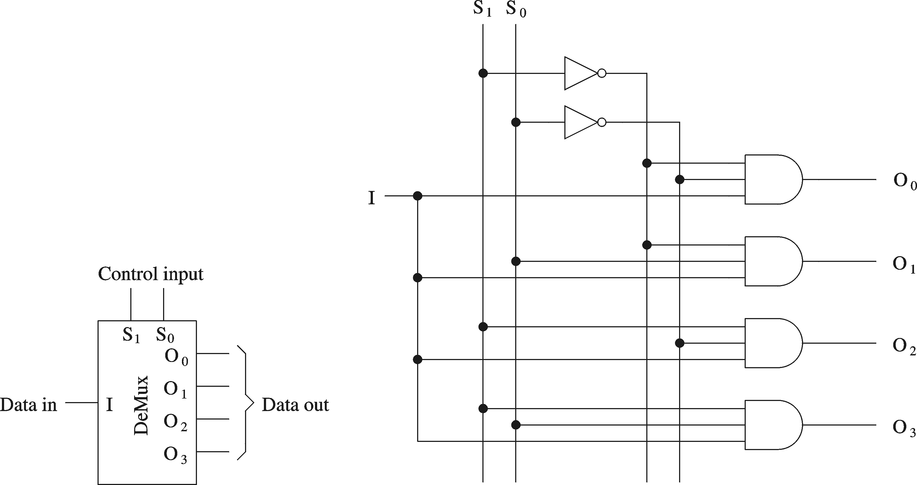
1-to-4 Demultiplexer

Slide 28
Encoders
w
2
n
–
1
y
n
–
1
2
n
n
inputs
outputs
y
0
w
0
Encoder
  2^{n} binary inputs
  n binary outputs
  Function: encodes information into an n-bit code
  Called 2^{n}-to-n encoder
    Can consider 2^{n} binary inputs as a single 2^{n}-bit input
    Can consider n binary output as a single n-bit output
Encoders only work when exactly one binary input is equal to 1

Slide 29
Priority Encoder
w
0
y
0
w
1
y
1
w
2
w
z
3
w
3
w
2
w
1
w
0
y
1
y
0
z
0
0
0
0
d
d
0
0
0
0
1
0
0
1
0
0
1
x
0
1
1
0
1
x
x
1
0
1
1
x
x
x
1
1
1

Slide 30
VHDL code for a Priority Encoder
LIBRARY ieee ;
USE ieee.std_logic_1164.all ;
ENTITY priority IS
PORT ( w : IN STD_LOGIC_VECTOR(3 DOWNTO 0) ;
y : OUT STD_LOGIC_VECTOR(1 DOWNTO 0) ;
z : OUT STD_LOGIC ) ;
END priority ;
ARCHITECTURE dataflow OF priority IS
BEGIN
y <= "11" WHEN w(3) = '1' ELSE
"10" WHEN w(2) = '1' ELSE
"01" WHEN w(1) = '1' ELSE
"00" ;
z <= '0' WHEN w = "0000" ELSE '1' ;
END dataflow ;

Slide 31
Single-Bit Adders
Half-adder
  Adds two binary (i.e. 1-bit) inputs A and B
    Produces a sum and carryout
  Problem: Cannot use it alone to build larger adders
Full-adder
  Adds three binary (i.e. 1-bit) inputs A, B, and carryin
    Like half-adder, produces a sum and carryout
  Allows building M-bit adders (M > 1)
    Simple technique
      Connect C_{out} of one adder to C_{in} of the next
    These are called ripple-carry adders
    Shown in next section

Slide 32
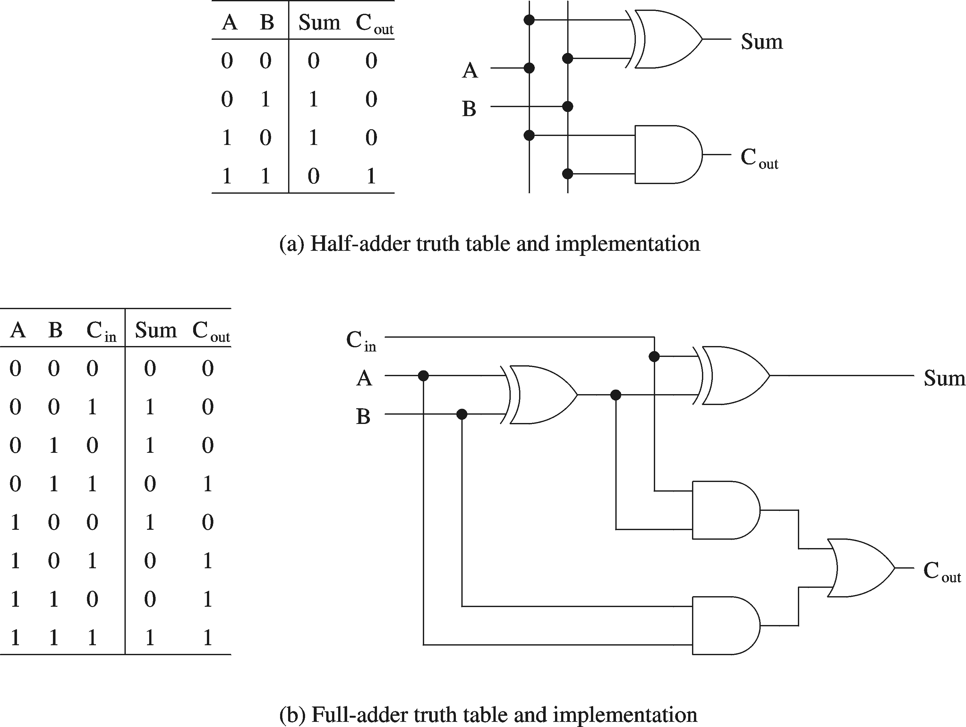
Single-Bit Adders (cont’d)

Slide 33
Multi-Bit Combinational Logic Building Blocks

Slide 34
Multi-bit 4-to-1 Multiplexer
s
0
s
1
s
1
s
0
f
w
0
00
0
0
w
0
w
1
01
f
0
1
w
1
w
2
10
1
0
w
w
3
11
8
w
2
1
1
3
8
(a) Graphic symbol
(b) Truth table
When drawing schematics, can draw multi-bit multiplexers
Example: 4-to-1 (8 bit) multiplexer
  4 inputs (each 8 bits)
  1 output (8 bits)
  2 selection bits
Can also have multi-bit 2-to-1 muxes, 16-to-1 muxes, etc.

Slide 35
4-to-1 (8-bit) Multiplexer
s
0
s
1
w₀(7)
00
w₁(7)
01
w₂(7)
10
f(7)
w₃(7)
11
A 4-to-1 (8-bit) multiplexer is composed
of eight 4-to-1 (1-bit) multiplexers
s
0
s
0
s
1
s
1
w₀(6)
w
w₁(6)
00
w
0
00
=
01
f(6)
1
01
f
w₂(6)
10
w
2
10
w₃(6)
11
w
3
11
8
8
s
0
s
1
w₀(0)
00
w₁(0)
01
w₂(0)
10
f(0)
w₃(0)
11

Slide 36
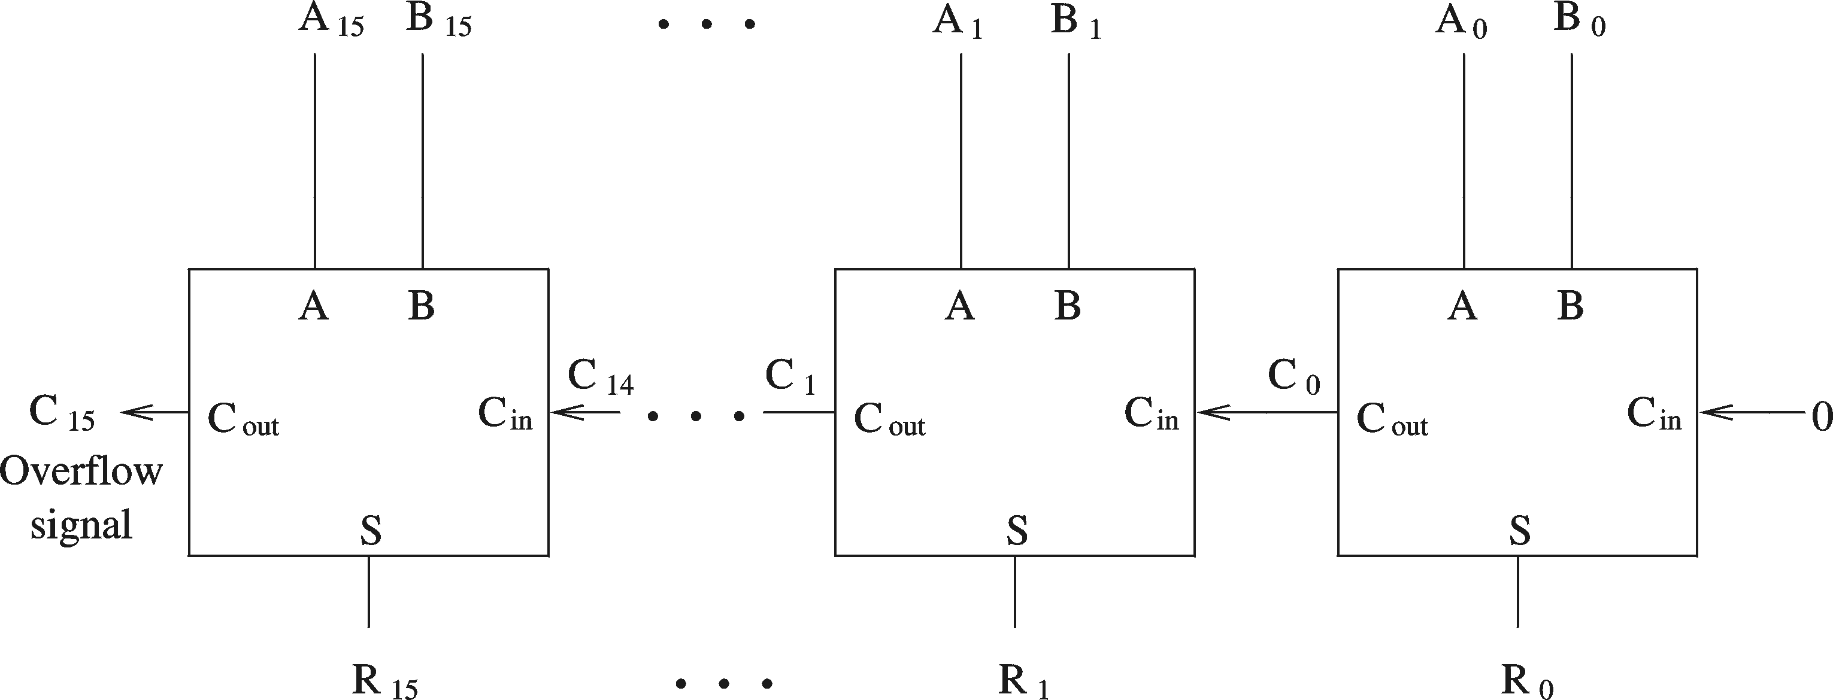
Multi-Bit Ripple-Carry Adder
A 16-bit ripple-carry adder is composed of 16 (1-bit) full adders
Inputs: 16-bit A, 16-bit B, 1-bit carryin (set to zero in the figure below)
Outputs: 16-bit sum R, 1-bit overflow
Called a ripple-carry adder because carry ripples from one full-adder to the next.
Critical path is 16 full-adders.

Slide 37
Comparator
Used two compare two M-bit numbers and produce a flag (M >1)
  Inputs: M-bit input A, M-bit input B
  Output: 1-bit output flag
    1 indicates condition is met
    0 indicates condition is not met
  Can compare: >, >=, <, <=, =, etc.
A
A > B?
M
1 if A > B
0 if A <= B
B
M

Slide 38
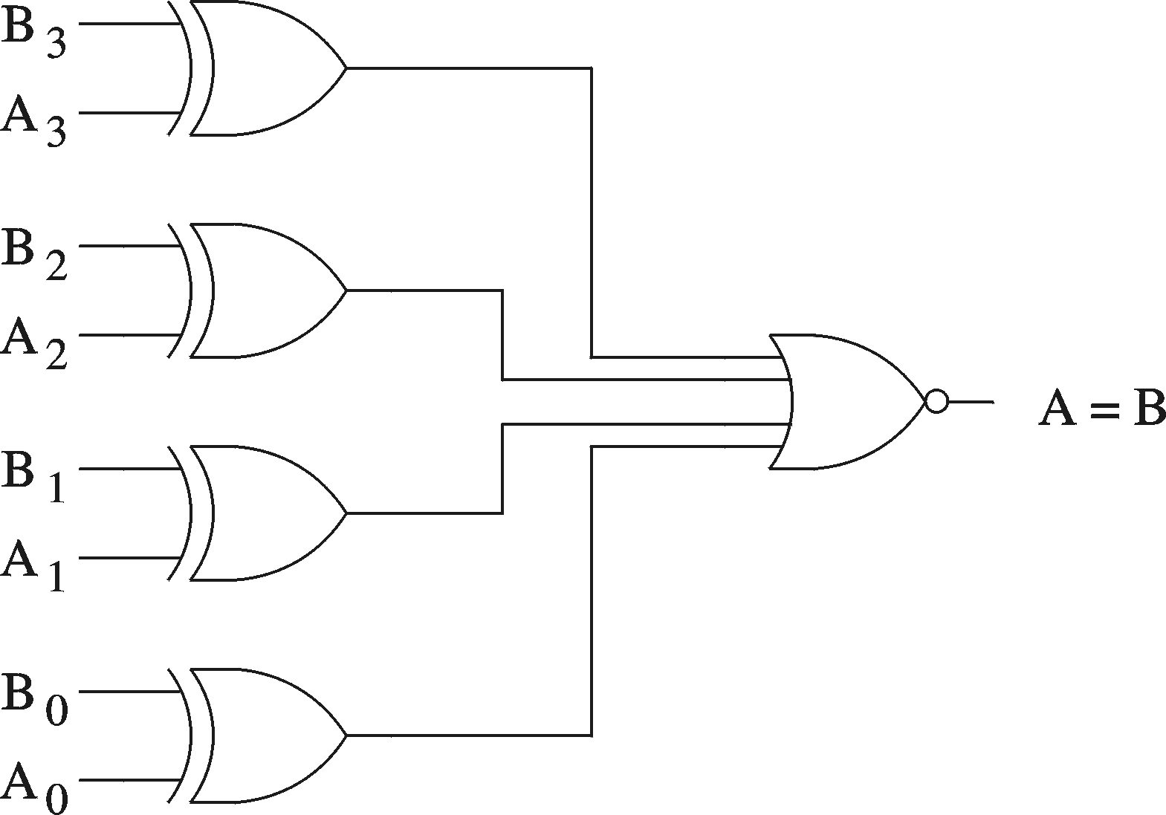
Example: 4-bit comparator (A = B)
A
A = B?
4
1 if A = B
0 if A != B
B
4

Slide 39
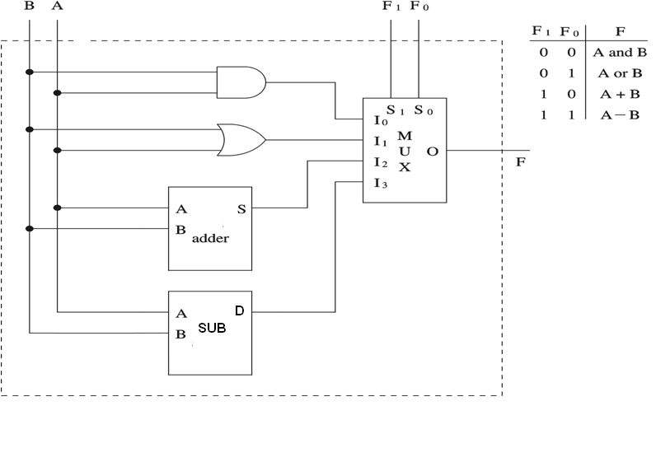
Combinational Logic Example: ALU (1-bit)
Preliminary ALU design (ALU = arithmetic + logic unit)

Slide 40
Sequential Circuit Designing Using VHDL

Slide 41
D Latch vs. D Flip-Flop
D
Q
D
CLK
CLK
Q
Latch transparent when clock is high
D
D
Q
CLK
CLK
Q
“Samples” D on rising edge of clock

Slide 42
D Latch
LIBRARY ieee ;
USE ieee.std_logic_1164.all ;
ENTITY latch IS
PORT ( D, Clock : IN STD_LOGIC ;
Q : OUT STD_LOGIC) ;
END latch ;
ARCHITECTURE Behavior OF latch IS
BEGIN
PROCESS ( D, Clock )
BEGIN
IF Clock = '1' THEN
Q <= D ;
END IF ;
END PROCESS ;
END Behavior;
D
Q
Clock
Process is sensitive to D and clock

Slide 43
D Flip-Flop: Standard Coding Style
LIBRARY ieee ;
USE ieee.std_logic_1164.all ;
ENTITY flipflop IS
PORT ( D, Clock : IN STD_LOGIC ;
Q : OUT STD_LOGIC) ;
END flipflop ;
ARCHITECTURE Behavior_1 OF flipflop IS
BEGIN
PROCESS ( Clock )
BEGIN
IF (Clock'EVENT AND Clock = '1') THEN
Q <= D ;
END IF ;
END PROCESS ;
END Behavior_1 ;
D
Q
Clock
Process sensitive to only clock
(changes in D do not matter if clock is not changing)

Slide 44
D Flip-Flop: Alternate Coding Style #1
LIBRARY ieee ;
USE ieee.std_logic_1164.all ;
ENTITY flipflop IS
PORT ( D, Clock : IN STD_LOGIC ;
Q : OUT STD_LOGIC) ;
END flipflop ;
ARCHITECTURE Behavior_1 OF flipflop IS
BEGIN
PROCESS ( Clock )
BEGIN
IF rising_edge(Clock) THEN
Q <= D ;
END IF ;
END PROCESS ;
END Behavior_1 ;
D
Q
Clock

Slide 45
D Flip-Flop: Alternate Coding Style #2
LIBRARY ieee ;
USE ieee.std_logic_1164.all ;
ENTITY flipflop IS
PORT ( D, Clock : IN STD_LOGIC ;
Q : OUT STD_LOGIC) ;
END flipflop ;
ARCHITECTURE Behavior_2 OF flipflop IS
BEGIN
PROCESS (clock)
BEGIN
WAIT UNTIL Clock'EVENT AND Clock = '1' ;
Q <= D ;
END PROCESS ;
END Behavior_2 ;
D
Q
Clock

Slide 46
D Flip-Flop: Alternate Coding Style #3
LIBRARY ieee ;
USE ieee.std_logic_1164.all ;
ENTITY flipflop IS
PORT ( D, Clock : IN STD_LOGIC ;
Q : OUT STD_LOGIC) ;
END flipflop ;
ARCHITECTURE Behavior_2 OF flipflop IS
BEGIN
PROCESS (clock)
BEGIN
WAIT UNTIL rising_edge(Clock) ;
Q <= D ;
END PROCESS ;
END Behavior_2 ;
D
Q
Clock

Slide 47
D flip-flop with asynchronous reset
LIBRARY ieee ;
USE ieee.std_logic_1164.all ;
ENTITY flipflop IS
PORT ( D, Resetn, Clock : IN STD_LOGIC ;
Q : OUT STD_LOGIC) ;
END flipflop ;
ARCHITECTURE Behavior OF flipflop IS
BEGIN
PROCESS ( Resetn, Clock )
BEGIN
IF Resetn = '0' THEN
Q <= '0' ;
ELSIF (Clock'EVENT AND Clock = '1') THEN
Q <= D ;
END IF ;
END PROCESS ;
END Behavior ;
D
Q
Clock
Resetn
Bubble means
active-low reset
(written resetn for
reset “not”)

Slide 48
D flip-flop with synchronous reset
LIBRARY ieee ;
USE ieee.std_logic_1164.all ;
ENTITY flipflop IS
PORT ( D, Resetn, Clock : IN STD_LOGIC ;
Q : OUT STD_LOGIC) ;
END flipflop ;
ARCHITECTURE Behavior OF flipflop IS
BEGIN
PROCESS (Clock)
BEGIN
IF (Clock'EVENT AND Clock = '1') THEN
IF (Resetn = '0') THEN
Q <= '0' ;
ELSE
Q <= D ;
END IF ;
END IF ;
END PROCESS ;
END Behavior ;
D
Q
Clock
Resetn

Slide 49
8-bit register with asynchronous reset
LIBRARY ieee ;
USE ieee.std_logic_1164.all ;
ENTITY reg8 IS
PORT ( D : IN STD_LOGIC_VECTOR(7 DOWNTO 0) ;
Resetn, Clock : IN STD_LOGIC ;
Q : OUT STD_LOGIC_VECTOR(7 DOWNTO 0) ) ;
END reg8 ;
ARCHITECTURE Behavior OF reg8 IS
BEGIN
PROCESS ( Resetn, Clock )
BEGIN
IF (Resetn = '0') THEN
Q <= "00000000" ;
ELSIF (Clock'EVENT AND Clock = '1') THEN
Q <= D ;
END IF ;
END PROCESS ;
END Behavior ;
8
Resetn
8
D
Q
Clock
reg8
Recall: Register is just a collection of D flip-flops

Slide 50
Implement an 8-bit register with asynchronous reset using Structural Approach

Slide 51
Counters

Slide 52
2-bit up-counter with synchronous reset
LIBRARY ieee ;
USE ieee.std_logic_1164.all ;
USE ieee.std_logic_unsigned.all ;
Use ieee.std_logic_arith.all ;
ENTITY upcount IS
PORT ( Clear, Clock : IN STD_LOGIC ;
Q : OUT STD_LOGIC_VECTOR(1 DOWNTO 0) ) ;
END upcount ;
ARCHITECTURE Behavior OF upcount IS
SIGNAL Count : std_logic_vector(1 downto 0);
BEGIN
upcount: PROCESS ( Clock )
BEGIN
IF (Clock'EVENT AND Clock = '1') THEN
IF (Clear = '1') THEN
Count <= "00" ;
ELSE
Count <= Count + 1 ;
END IF ;
END IF;
END PROCESS;
Q <= Count;
END Behavior ;
Clear
2
Q
upcount
Clock
Assigned outside the process

Slide 53
4-bit up-counter with asynchronous reset (1)
LIBRARY ieee ;
USE ieee.std_logic_1164.all ;
USE ieee.std_logic_unsigned.all ;
ENTITY upcount IS
PORT ( Clock, Resetn, Enable : IN STD_LOGIC ;
Q : OUT STD_LOGIC_VECTOR (3 DOWNTO 0)) ;
END upcount ;
Enable
4
Q
Clock
upcount
Resetn

Slide 54
4-bit up-counter with asynchronous reset (2)
ARCHITECTURE Behavior OF upcount IS
SIGNAL Count : STD_LOGIC_VECTOR (3 DOWNTO 0) ;
BEGIN
PROCESS ( Clock, Resetn )
BEGIN
IF Resetn = '0' THEN
Count <= "0000" ;
ELSIF (Clock'EVENT AND Clock = '1') THEN
IF (Enable = '1') THEN
Count <= Count + 1 ;
END IF ;
END IF ;
END PROCESS ;
Q <= Count ;
END Behavior ;
Enable
4
Q
Clock
upcount
Resetn

Slide 55
Named association connectivity
recommended in majority of cases,
prevents ommisions and mistakes
COMPONENT dec2to4
PORT (w : IN STD_LOGIC_VECTOR(1 DOWNTO 0) ;
En : IN STD_LOGIC ;
y : OUT STD_LOGIC_VECTOR(0 TO 3) ) ;
END COMPONENT ;
u4: dec2to4 PORT MAP (w => q,
En => ena,
y => z);

Slide 56
Positional association connectivity
Allowed for cases of
  small number of ports
  multiple instantiations of the same component, in regular structures
COMPONENT dec2to4
PORT (w : IN STD_LOGIC_VECTOR(1 DOWNTO 0) ;
En : IN STD_LOGIC ;
y : OUT STD_LOGIC_VECTOR(0 TO 3) ) ;
END COMPONENT ;
u4: dec2to4 PORT MAP (q, ena, z);

Slide 57
Structural description with positional association connectivity
BEGIN
u1: mux2to1 PORT MAP (r(0), r(1), s(0), p(0));
p(1) <= r(2);
p(1) <= r(3);
u2: mux2to1 PORT MAP (r(4) , r(5), s(1), p(3));
u3: priority PORT MAP (p, q, ena);
u4: dec2to4 PORT MAP (q, ena, z);
u5: regn GENERIC MAP(4) PORT MAP (z, En, Clk, t);
END structural;

Slide 58
METHOD #1: Explicit Component Declaration
Put entity .vhd files all in same directory
Declare components in main code
Architecture structural is
  COMPONENT mux2to1
  PORT (w0, w1, s : IN STD_LOGIC ;
  f : OUT STD_LOGIC ) ;
  END COMPONENT ;
  COMPONENT priority
  PORT (w : IN STD_LOGIC_VECTOR(3 DOWNTO 0) ;
  y : OUT STD_LOGIC_VECTOR(1 DOWNTO 0) ;
  z : OUT STD_LOGIC ) ;
  END COMPONENT ;
begin

Slide 59
METHOD #2: Package component declaration
Components declared in package
Actual instantiations and port maps always in main code

Slide 60
Packages
Instead of declaring all components can declare all components in a PACKAGE, and INCLUDE the package once
  This makes the top-level entity code cleaner
  It also allows that complete package to be used by another designer
A package can contain
  Components
  Functions, Procedures
  Types, Constants

Slide 61
Package – example (1)
LIBRARY ieee ;
USE ieee.std_logic_1164.all ;
PACKAGE GatesPkg IS
  COMPONENT mux2to1
  PORT (w0, w1, s : IN STD_LOGIC ;
  f : OUT STD_LOGIC ) ;
  END COMPONENT ;
  COMPONENT priority
  PORT (w : IN STD_LOGIC_VECTOR(3 DOWNTO 0) ;
  y : OUT STD_LOGIC_VECTOR(1 DOWNTO 0) ;
  z : OUT STD_LOGIC ) ;
  END COMPONENT ;

Slide 62
Package – example (2)
  COMPONENT dec2to4
  PORT (w : IN STD_LOGIC_VECTOR(1 DOWNTO 0) ;
  En : IN STD_LOGIC ;
  y : OUT STD_LOGIC_VECTOR(0 TO 3) ) ;
  END COMPONENT ;
  COMPONENT regn
  GENERIC ( N : INTEGER := 8 ) ;
  PORT ( D : IN STD_LOGIC_VECTOR(N-1 DOWNTO 0) ;
  Enable, Clock : IN STD_LOGIC ;
  Q : OUT STD_LOGIC_VECTOR(N-1 DOWNTO 0) ) ;
  END COMPONENT ;

Slide 63
Package – example (3)
  constant ADDAB : std_logic_vector(3 downto 0) := "0000";
  constant ADDAM : std_logic_vector(3 downto 0) := "0001";
  constant SUBAB : std_logic_vector(3 downto 0) := "0010";
  constant SUBAM : std_logic_vector(3 downto 0) := "0011";
  constant NOTA : std_logic_vector(3 downto 0) := "0100";
  constant NOTB : std_logic_vector(3 downto 0) := "0101";
  constant NOTM : std_logic_vector(3 downto 0) := "0110";
  constant ANDAB : std_logic_vector(3 downto 0) := "0111";
END GatesPkg;

Slide 64
Package usage (1)
LIBRARY ieee ;
USE ieee.std_logic_1164.all ;
USE work.GatesPkg.all;
ENTITY priority_resolver1 IS
PORT (r : IN STD_LOGIC_VECTOR(5 DOWNTO 0) ;
s : IN STD_LOGIC_VECTOR(1 DOWNTO 0) ;
clk : IN STD_LOGIC;
en : IN STD_LOGIC;
t : OUT STD_LOGIC_VECTOR(3 DOWNTO 0) ) ;
END priority_resolver1;
ARCHITECTURE structural OF priority_resolver1 IS
SIGNAL p : STD_LOGIC_VECTOR (3 DOWNTO 0) ;
SIGNAL q : STD_LOGIC_VECTOR (1 DOWNTO 0) ;
SIGNAL z : STD_LOGIC_VECTOR (3 DOWNTO 0) ;
SIGNAL ena : STD_LOGIC ;

Slide 65
Package usage (2)
BEGIN
u1: mux2to1 PORT MAP ( w0 => r(0) ,
w1 => r(1),
s => s(0),
f => p(0));
p(1) <= r(2);
p(2) <= r(3);
u2: mux2to1 PORT MAP ( w0 => r(4) ,
w1 => r(5),
s => s(1),
f => p(3));
u3: priority PORT MAP ( w => p,
y => q,
z => ena);
u4: dec2to4 PORT MAP ( w => q,
En => ena,
y => z);
u5: regn GENERIC MAP ( N => 4)
PORT MAP ( D => z ,
Enable => En ,
Clock => Clk,
Q => t );
END structural;

Slide 66
Explicit Component Declaration versus Package
Explicit component declaration is when you declare components in main code
  When have only a few component declarations, this is fine
  When have many component declarations, use packages for readability
Packages also help with portability and sharing of libraries among many users in a company
Remember, the actual instantiations always take place in main code
  Only the declarations can be in main code or package

Slide 67
Design Tips
Use Processes with IF and CASE statements only. Do not use LOOPS or VARIABLES.
Sensitivity list of the PROCESS should include only signals that can by themselves change the outputs of the circuit (typically, clock and asynchronous set or reset)
Do not use PROCESSes without sensitivity list
(they can be synthesizable, but make simulation inefficient)

Slide 68
Design Tips
4. Given a single signal, the assignments to this signal should
only be made within a single process block in order to avoid
possible conflicts in assigning values to this signal.
Process 1: PROCESS (a, b)
BEGIN
y <= a AND b;
END PROCESS;
Process 2: PROCESS (a, b)
BEGIN
y <= a OR b;
END PROCESS;
STATEMENTS WITHIN A
PROCESS ARE SEQUENTIAL...
BUT TWO PROCESSES ARE
CONCURRENT TO ONE ANOTHER.
THEY RUN IN PARALLEL

Slide 69
Design Tips
5. Describe the algorithm you are trying to implement in pseudocode.
6. Translate the pseudocode directly to VHDL using processes with IF, CASE, LOOP, and VARIABLES.

Slide 70
Circuit built of medium scale components
s(0)
r(0)
p(0)
En
0
r(1)
1
w
q(0)
Enable
p(1)
0
y
w
y
0
0
0
z(0)
t(0)
r(2)
w
q(1)
p(2)
1
y
w
y
1
1
1
r(3)
w
z(1)
t(1)
2
ena
D
Q
z
y
w
2
3
z(2)
t(2)
r(4)
p(3)
priority
y
0
En
3
z(3)
t(3)
dec2to4
regn
r(5)
1
Clk
Clock
s(1)

Slide 71
End of Session

